Slide 1
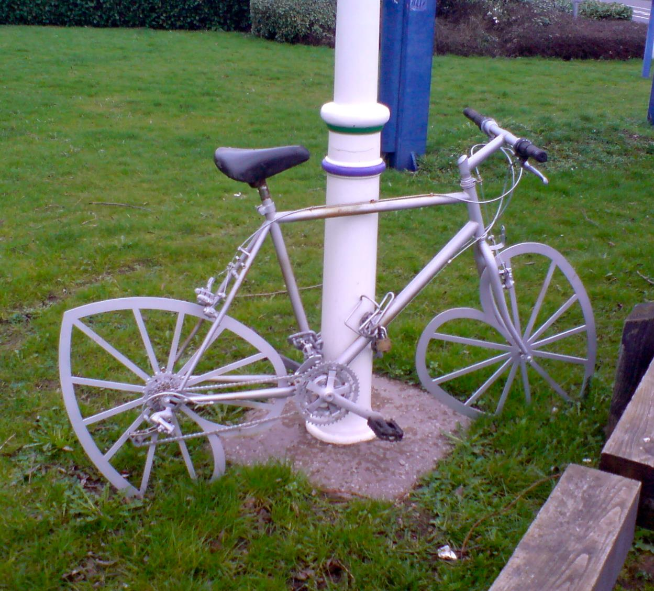

Don't Reinvent the Wheel, Just Realign It
Josh King
Credit: Thomas Guest

Slide 2
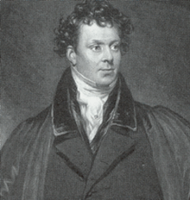
Who Am I?
Josh King
@WindosNZ

https://king.geek.nz
✶

Slide 3
Reinventing the Wheel?
Creating a new PowerShell module
Developing a complex class structure
Scraping information from web pages
Using (and contributing to) an existing one
Using existing .NET libraries
Using the damned API (you may need to ask!)

Slide 4

Why Does It Matter?
Time is money
Existing documentation and support
Building on existing tools benefits the entire community
Credit: Henti Smith

Slide 5
One Caveat…
If it’s your own time, and you find it interesting:
Reinvent which ever wheels you like!

Slide 6
CODE TIME!

Slide 7
CODE STORY TIME!

Slide 8

Takeaways
Use existing tools,
Focus on the specifics of your situation,
Not the time consuming foundations.
Contribute back to the community.
Be the time efficient, tool building hero your organization needs,
Not a speed bump!
Credit: S.S.K.

Slide 9
THANK YOU!
Get this slide deck from:
http://bit.ly/WindosReinvent
Get in touch:
@WindosNZ

